Slide 1

PowerShell and Bash Sittin’ in a Tree
>_
#!
Presented by:
Adam the Automator

Slide 2

PS> Whoami
Pluralsight Author
PowerShell Trainer
Freelance Writer
PowerShell Consultant
Blog: adamtheautomator.com
Twitter: @adbertram
Microsoft Content/ Datacenter Management MVP

Slide 3
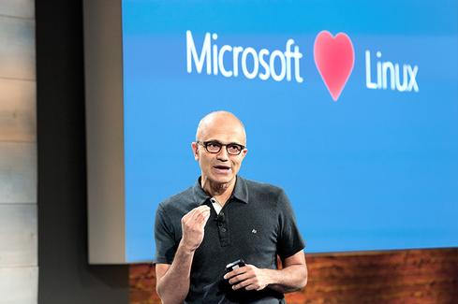
Microsoft Loves Linux

Slide 4
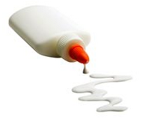
What is PowerShell? ...in One Slide?
Everything is an Object
Powerful Pipeline
Built on the .NET Framework
A Management and Scripting Tool
The Automation “Glue”

Slide 5



PowerShell's History
Built as an Automation Framework
Evolved due to Architecture Differences
>_
Originally intended to be Unix Tools for Windows
>_
>_

Slide 6

PowerShell vs. Bash
STD* Goes Away
String Parsing Goes Nil
PowerShell is .NET
Bash Utilities Only Represented Differently
In the end…It Doesn’t Really Matter
#!
>_

Slide 7




Our Worlds are Coming Together
The Goal is to Standardize
Companies Aren’t All Linux or All Windows
We’ll All Be Automators

Slide 8
Demo
#!
>_

